Slide 1

Object Detection
Intersection over union
deeplearning.ai

Slide 2
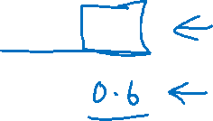
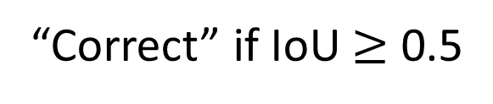
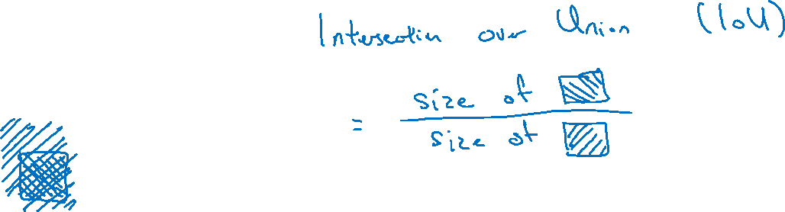
Evaluating object localization
“Correct” if IoU $≥$ 0.5
More generally, IoU is a measure of the overlap between two bounding boxes.

